Slide 1
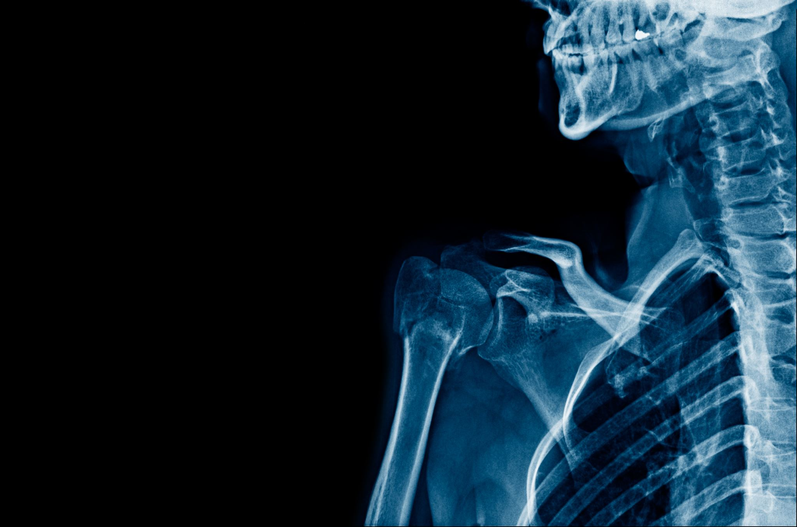
MAJOR THORACIC TRAUMA
LIBRETTI LIDIA, MD
Department of Thoracic Surgery
Fondazione IRCCS San Gerardo dei Tintori

Slide 2

BACKGROUND
60% mortality rate in Thoracic Trauma in Europe and the USA
20-25% of deaths in poly-trauma patients are due to thoracic lesions
Rib fractures present in 20% of cases
Motor vehicle crash, pedestrians struck by vehicles, falls, and crush injuries.
Usually about 40% of CWT need hospitalization

Slide 3
Morbidity and Mortality risk factors
Age > 65 years
Pulmonary or cardiovascular cronic disease
Alterated coagulation state
Multiple rib fractures
High energy trauma

Slide 4
CHEST WALL TRAUMA INJURIES

Slide 5
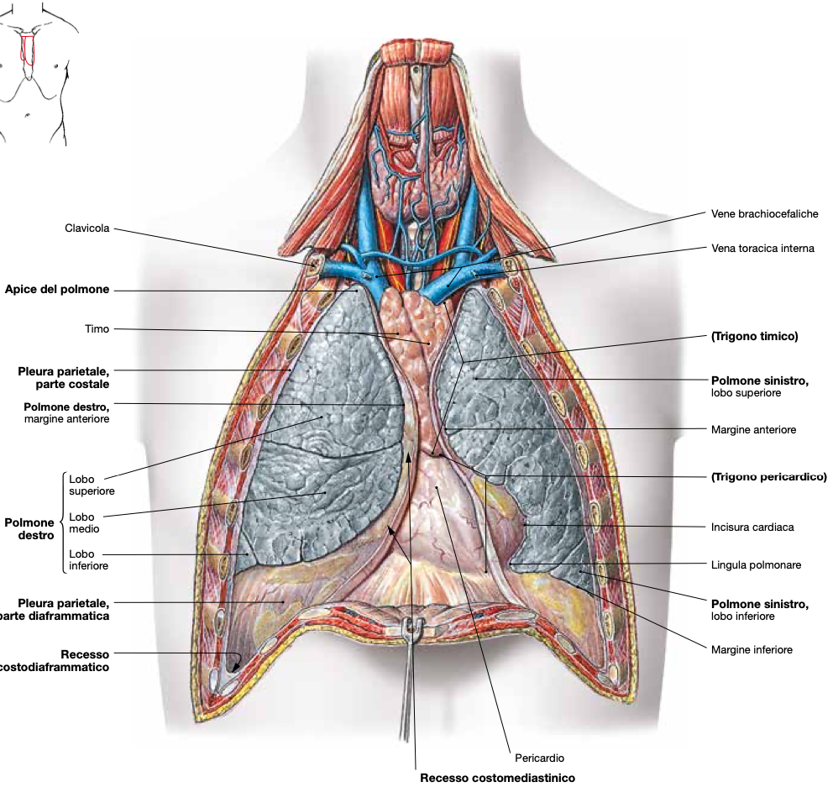
INTRA-THORACIC INJURIES

Slide 6
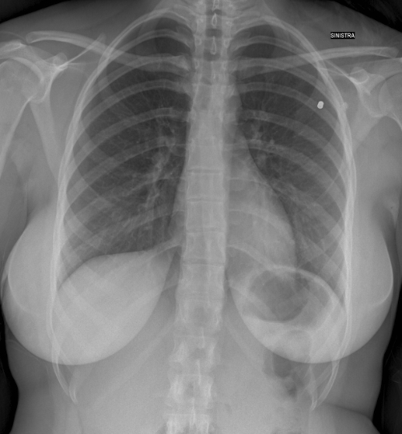
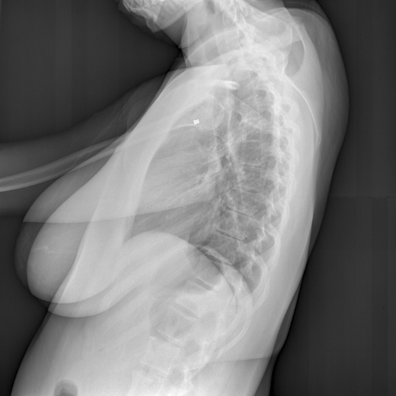
MECHANISMS OF INJURY
Blunt trauma
MVCs, falls, crush injuries
Deceleration → vascular shear stress
Penetrating trauma
Stab wounds, gunshot wounds
Trajectory more important than entry site

Slide 7
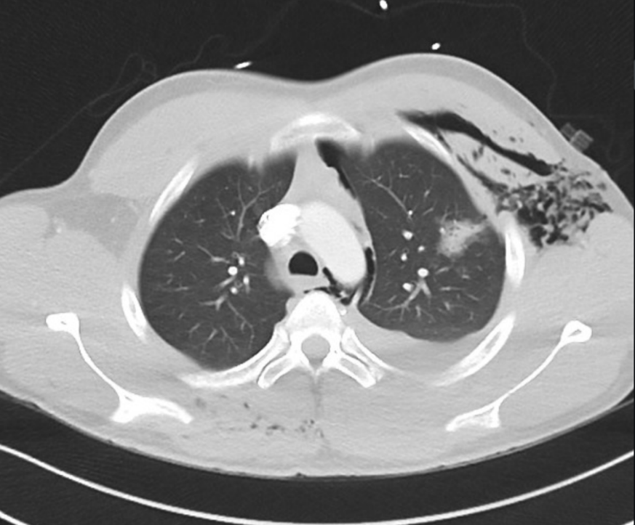
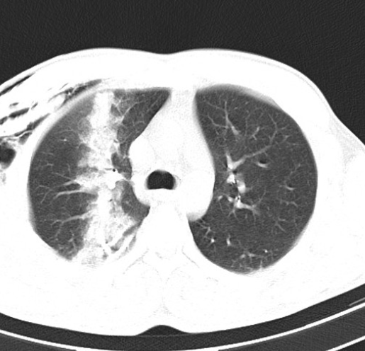
PENETRATING CHEST TRAUMA
Wide range of injuries: from superficial wounds to hemodynamic instability requiring immediate intervention.
Gunshot or explosive wounds cause less predictable injuries.
The trajectory of an object within the body may not follow a straight line: tissues can be damaged not only directly, but also by shock waves.
More rare than blunt chest trauma, but often are a life-threatening condition.

Slide 8
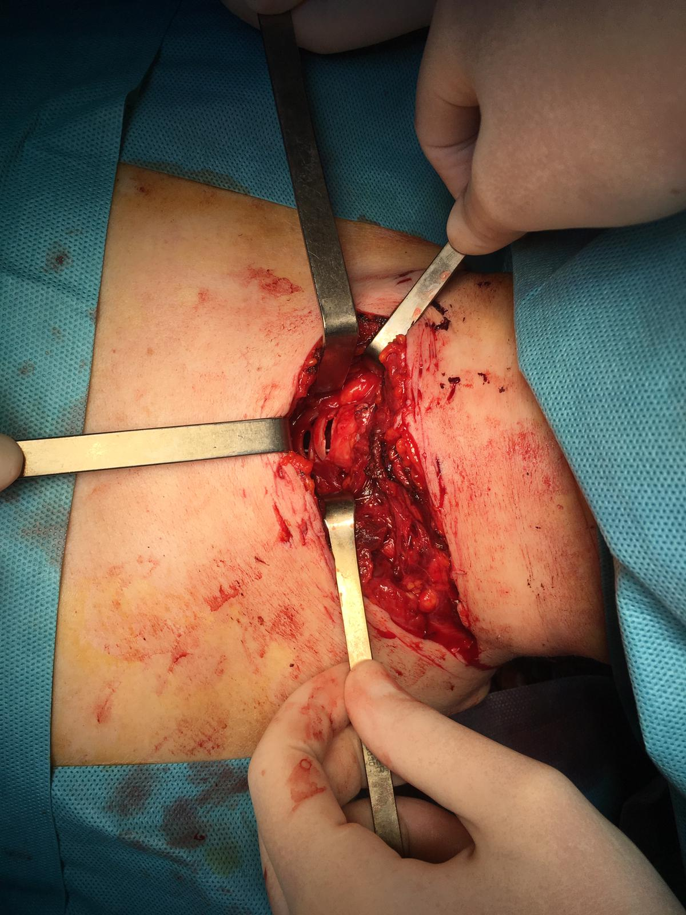
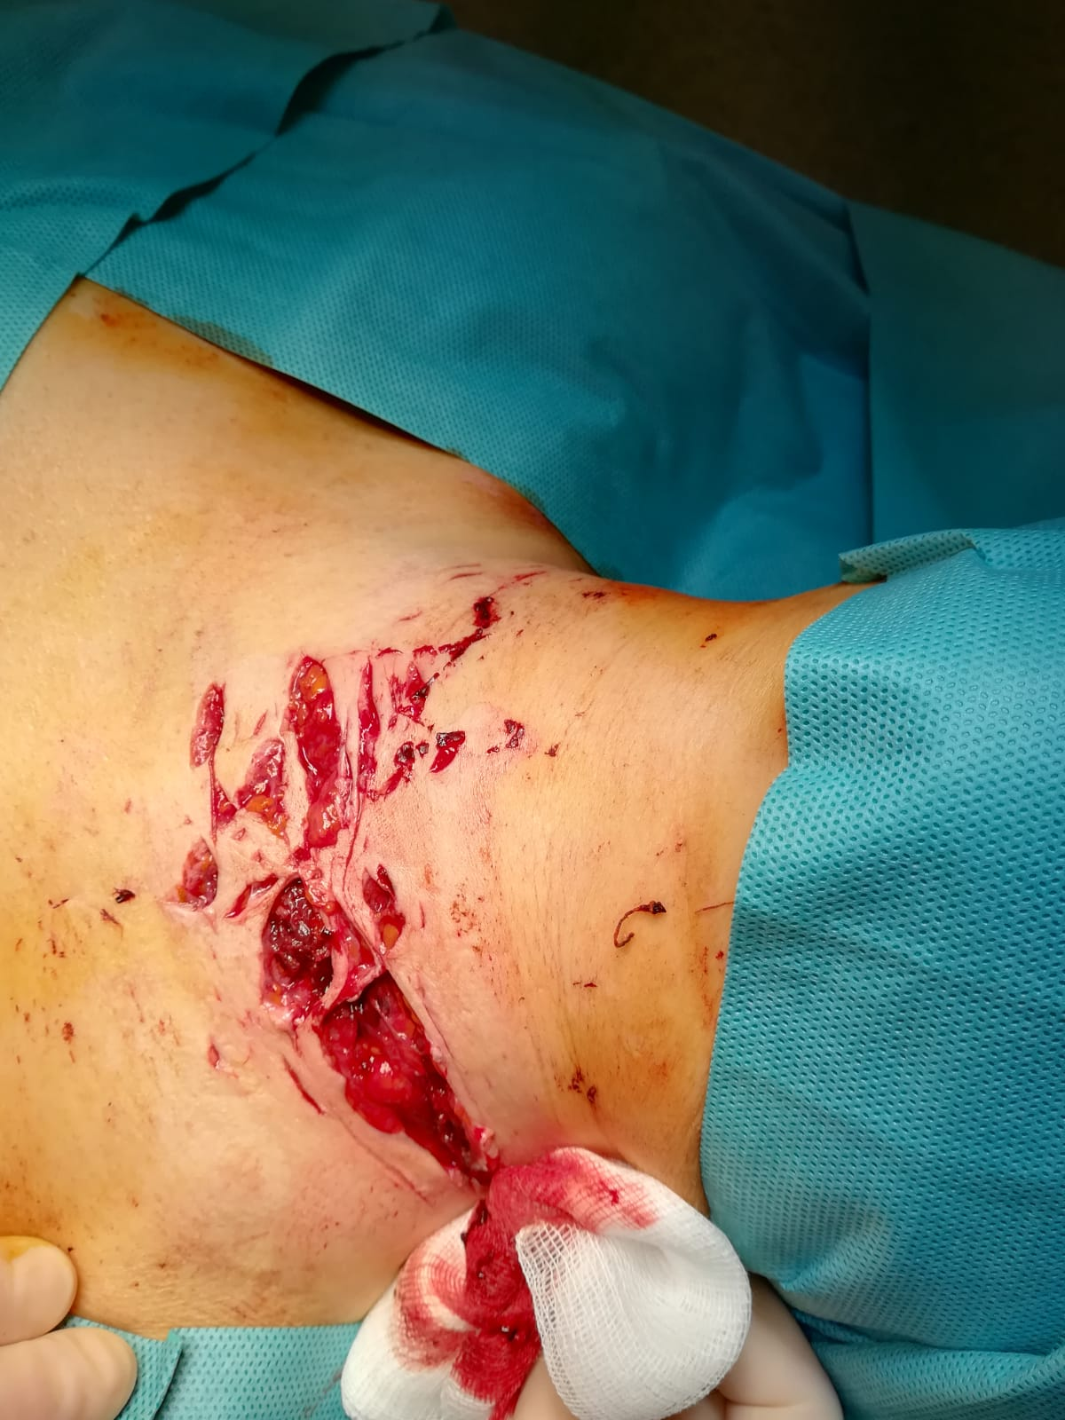
PENETRATING NECK TRAUMA

Slide 9
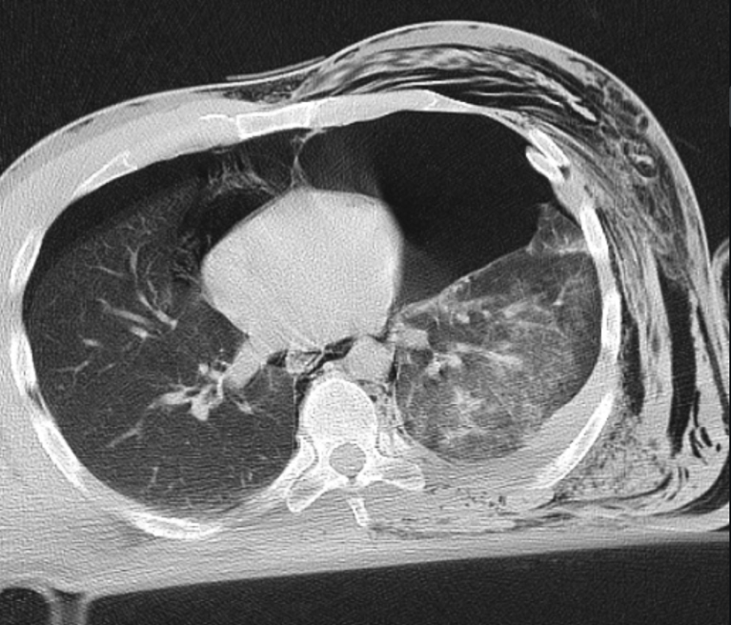
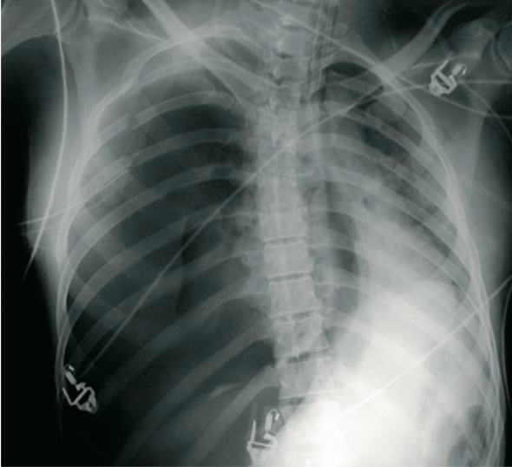
PNEUMOTHORAX
Air enters the pleural space secondary to a laceration of lung, bronchus or chest wall
Tension pneumothorax the airflow is unidirectional, causing a progressive accumulation of air in the pleural space
Collapse of the lung, hypoxia, shift of the mediastinum to the opposite side, kinking of great vessels, haemodinamic instability
It is a life-threatening condition
Needs immediate decompression!

Slide 10
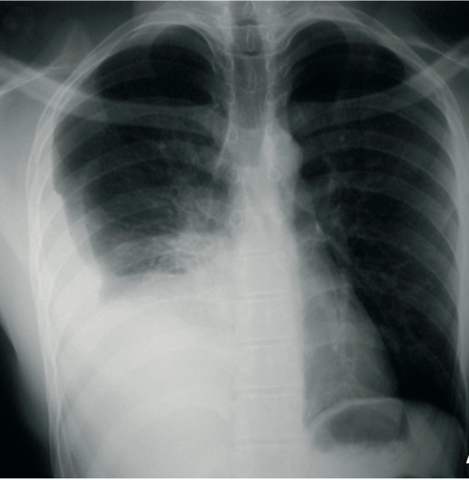
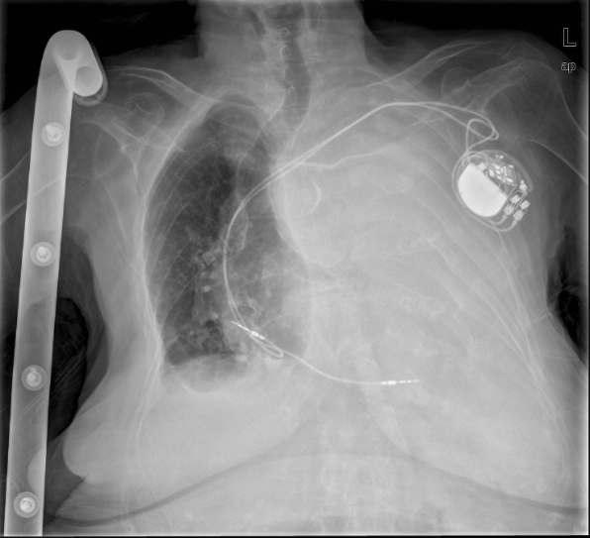
EMOTHORAX
Rib fracture with intercostal vessels lacerations, lung lacerations
Massive emothorax: > 1500 ml of blood in the hemithorax, or 200 ml x hour (3 ml/kg/h) from the chest drain: thoracotomy
Needs of drainage
In cases of retained emothorax, thoracoscopy may be necessary to prevent empiema

Slide 11
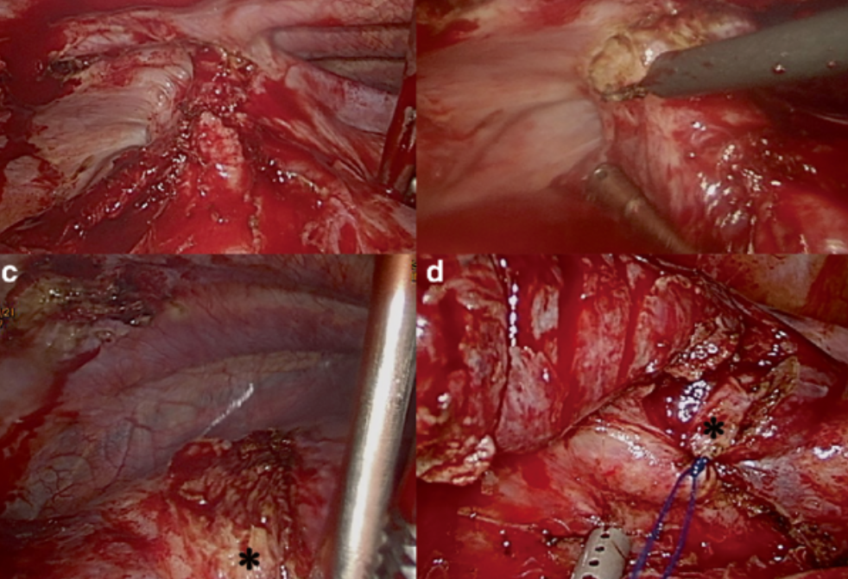
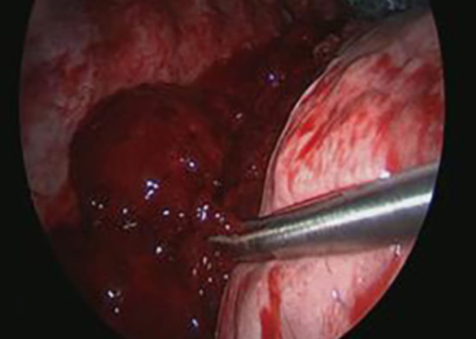
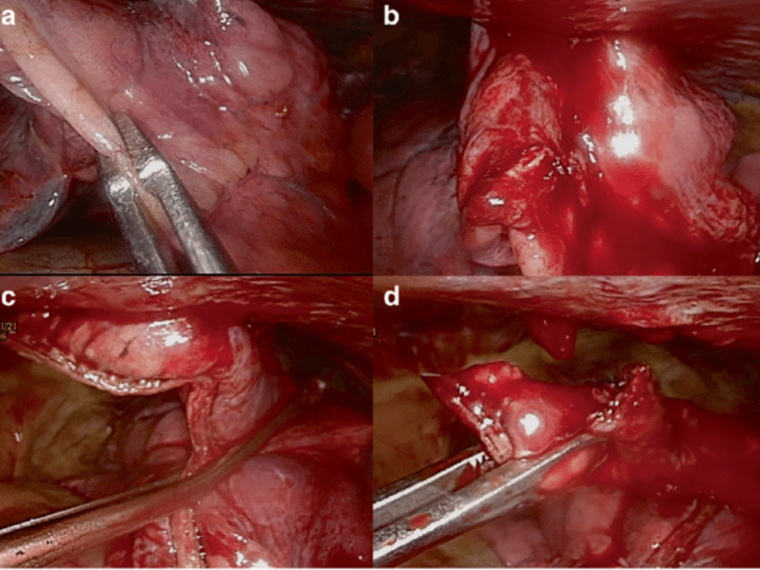
VATS Video Assisted Thoracoscopy
Explore pleural cavity, diagnose and treat thoracic lesions, evacuate emothorax, fix ribs

Slide 12
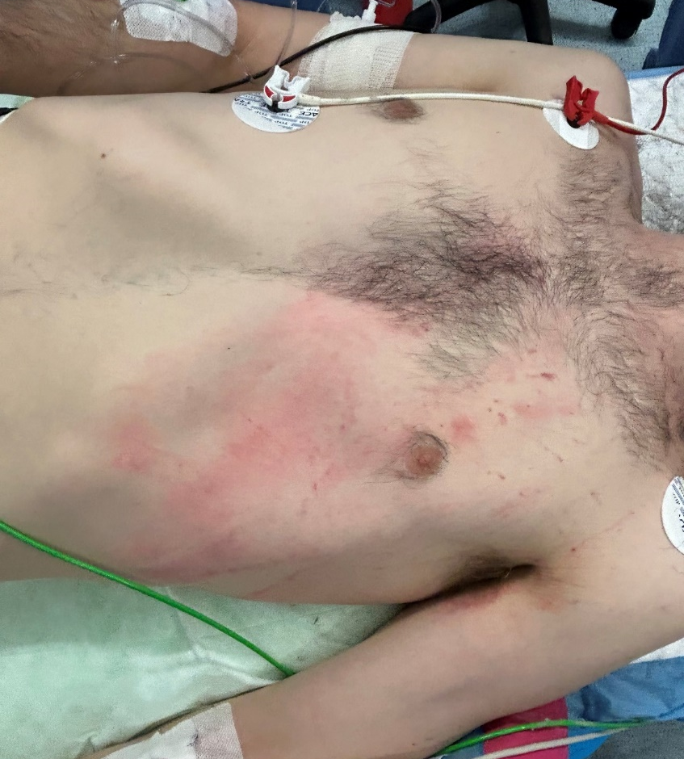
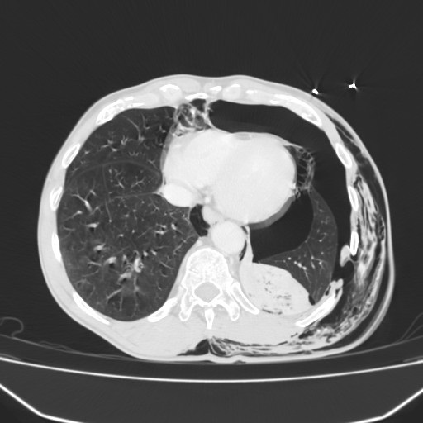
RIBS FRACTURES
Single, multiple, compound, displaced or comminuted fractures
Pain, slumping, discontinuity, clicking sensation or movement at deep inspiration, crepitation at palpation

Slide 13
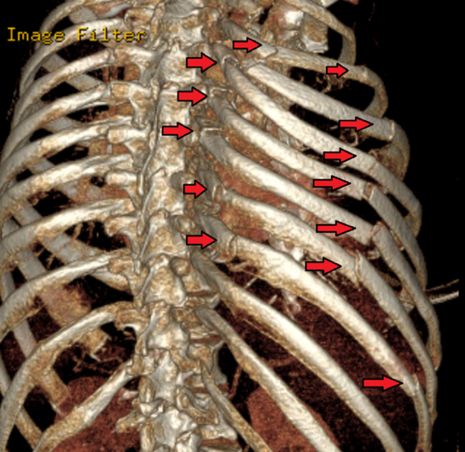
RIBS FRACTURES
Most often caused by blunt trauma
Ribs III to VIII are fractured most often
I and II ribs are injured by severe trauma
Intercostal vessel injury, lung lacerations, great vessels injury, visceral abdominal injuries
Respiratory restriction as a consequence of pain and immobilization (atelectasis, hypoventilation, inadequate cough, pneumonia)
Surgical indications: within 72h, flail chest, chest instability, multiple and displaced fractures, no pain control, pulmonary disorders

Slide 14
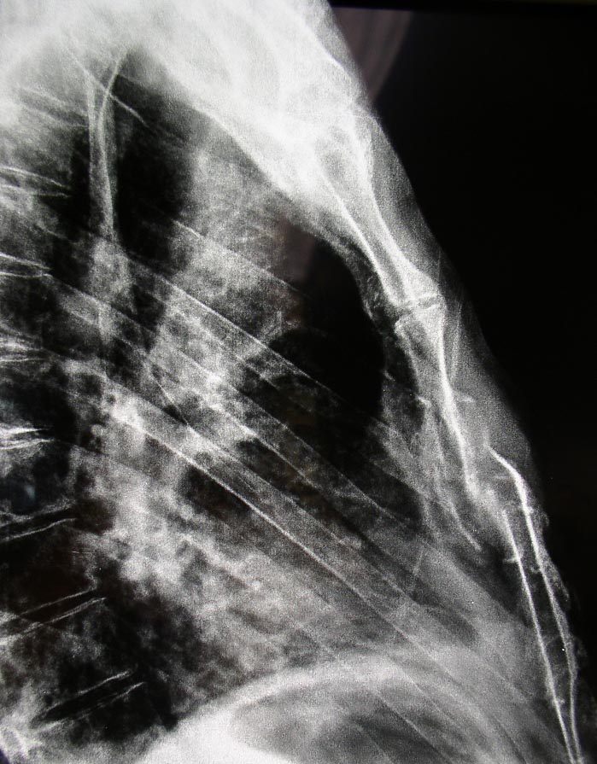
Rib fractures observed in about 20% of thoracic traumas FLAIL CHEST
Often associated with pulmonary contusions
Poor pain control
Reduced ventilation Worsening of respiratory exchanges
Ineffective sputum
Pneumonia
Mortality increase 30% + Deterioration of long-term quality of life
Respiratory failure
Notes:
Peggioramento della prognosi con incremento della mortalità fino al 30%. Il dolore cronico seguente fratture costali e sternali influisce negativamente sulla qualità della vita a lungo termine

Slide 15
PAIN MANAGEMENT

Slide 16
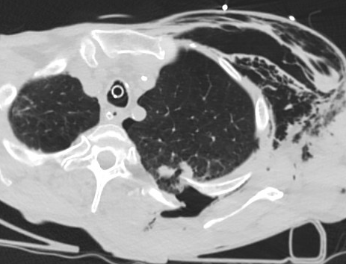
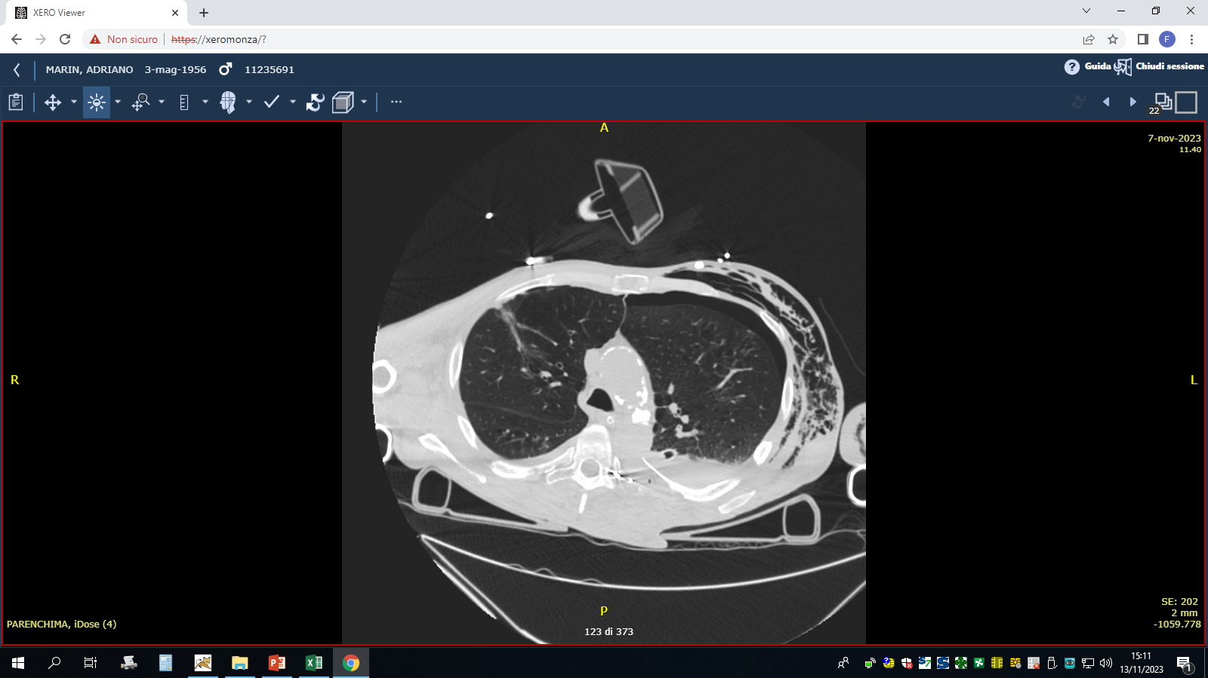
RIBS FRACTURES

Slide 17
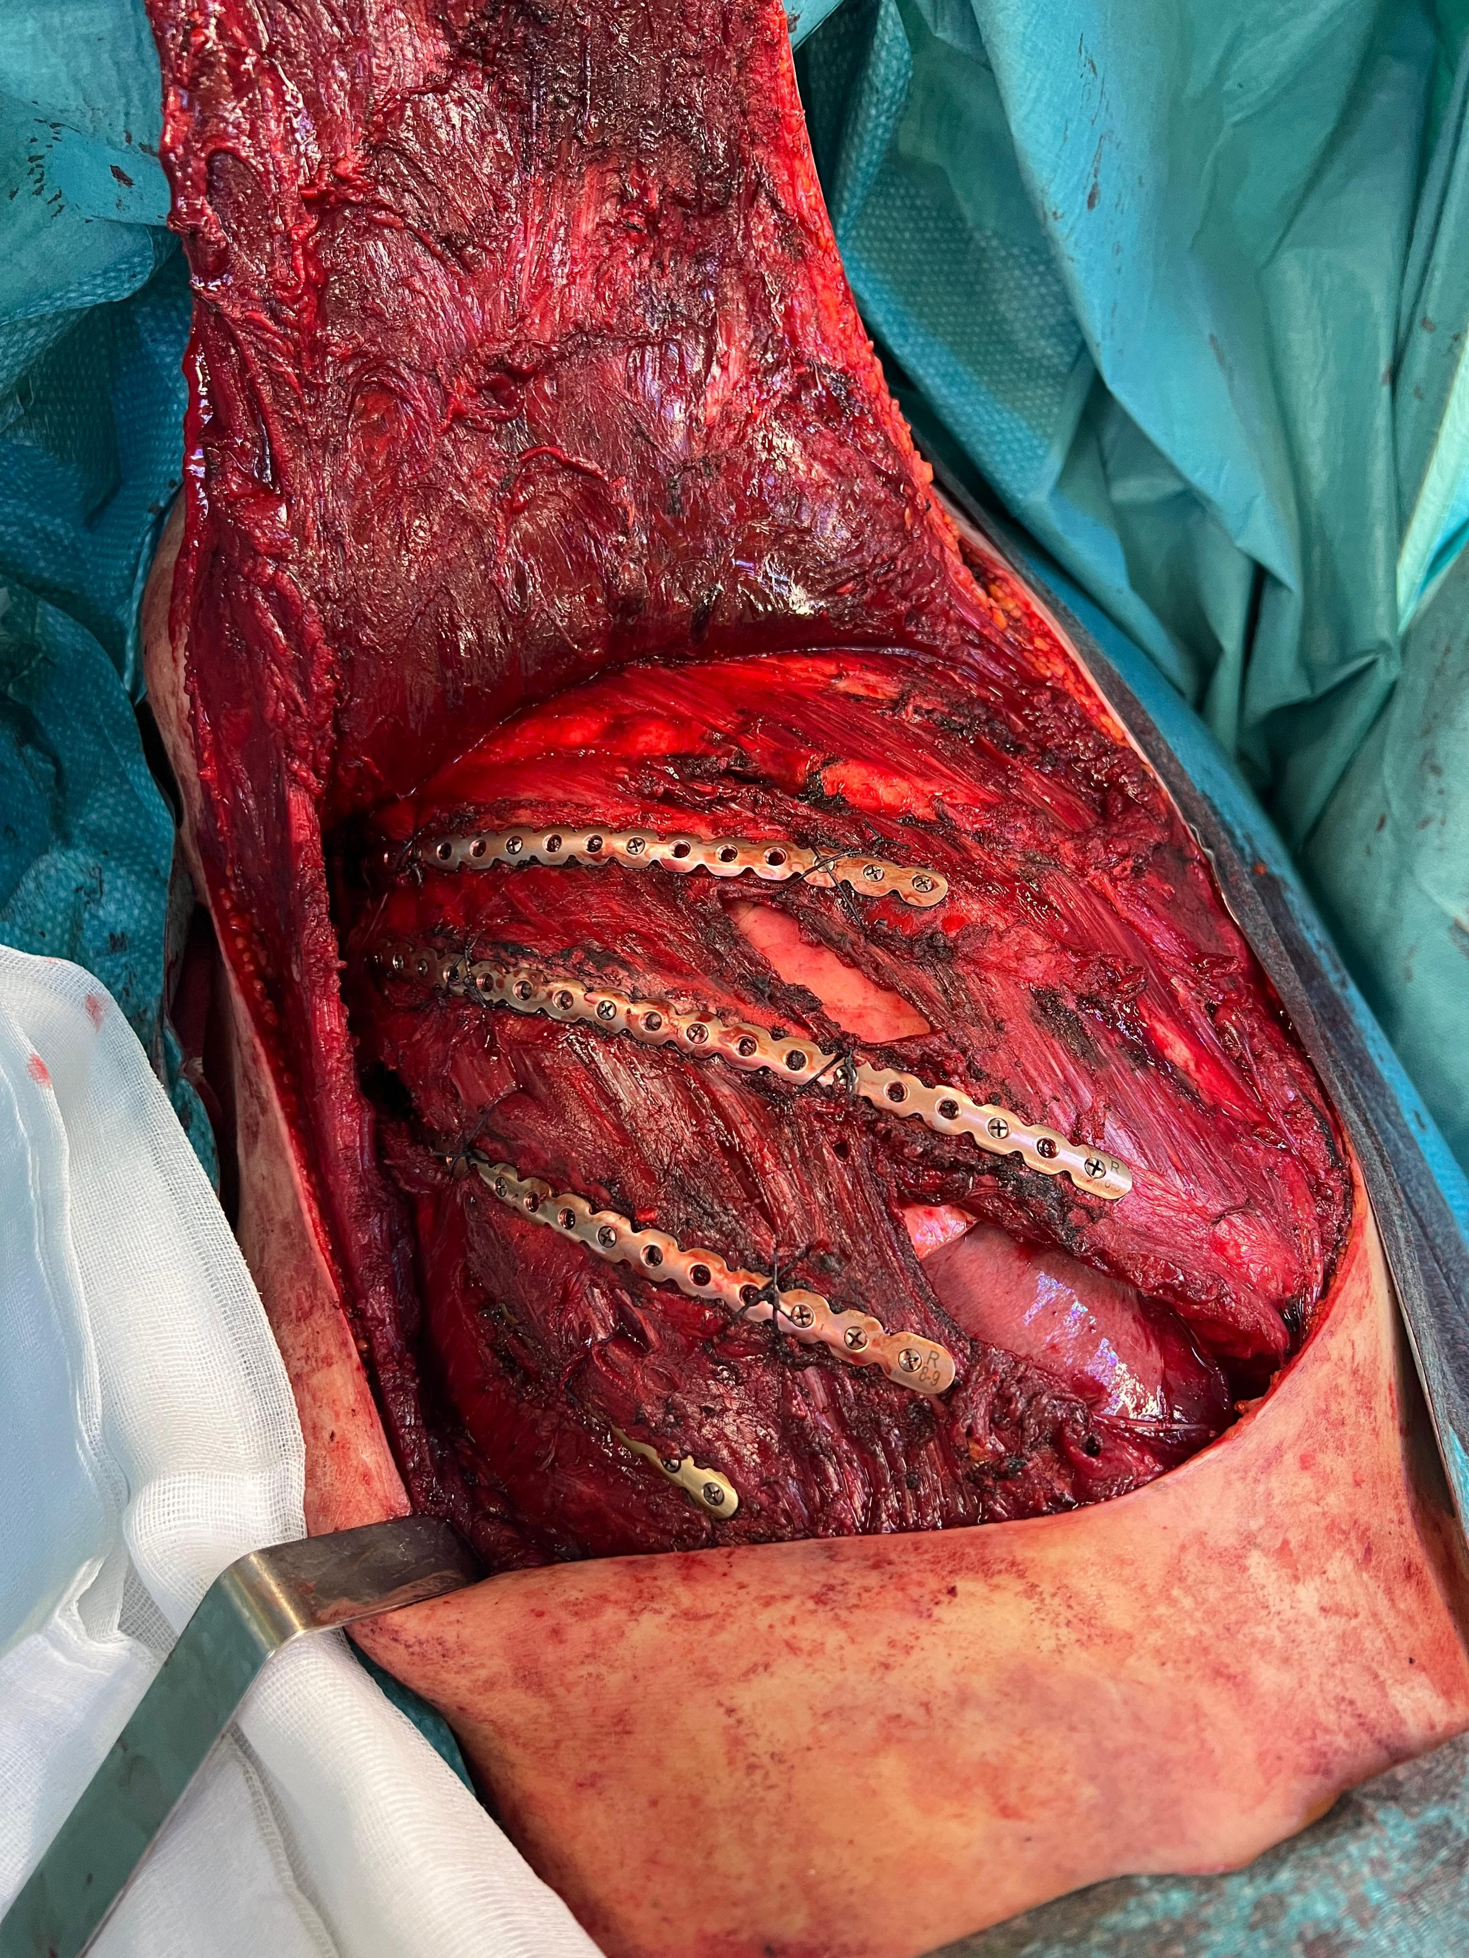
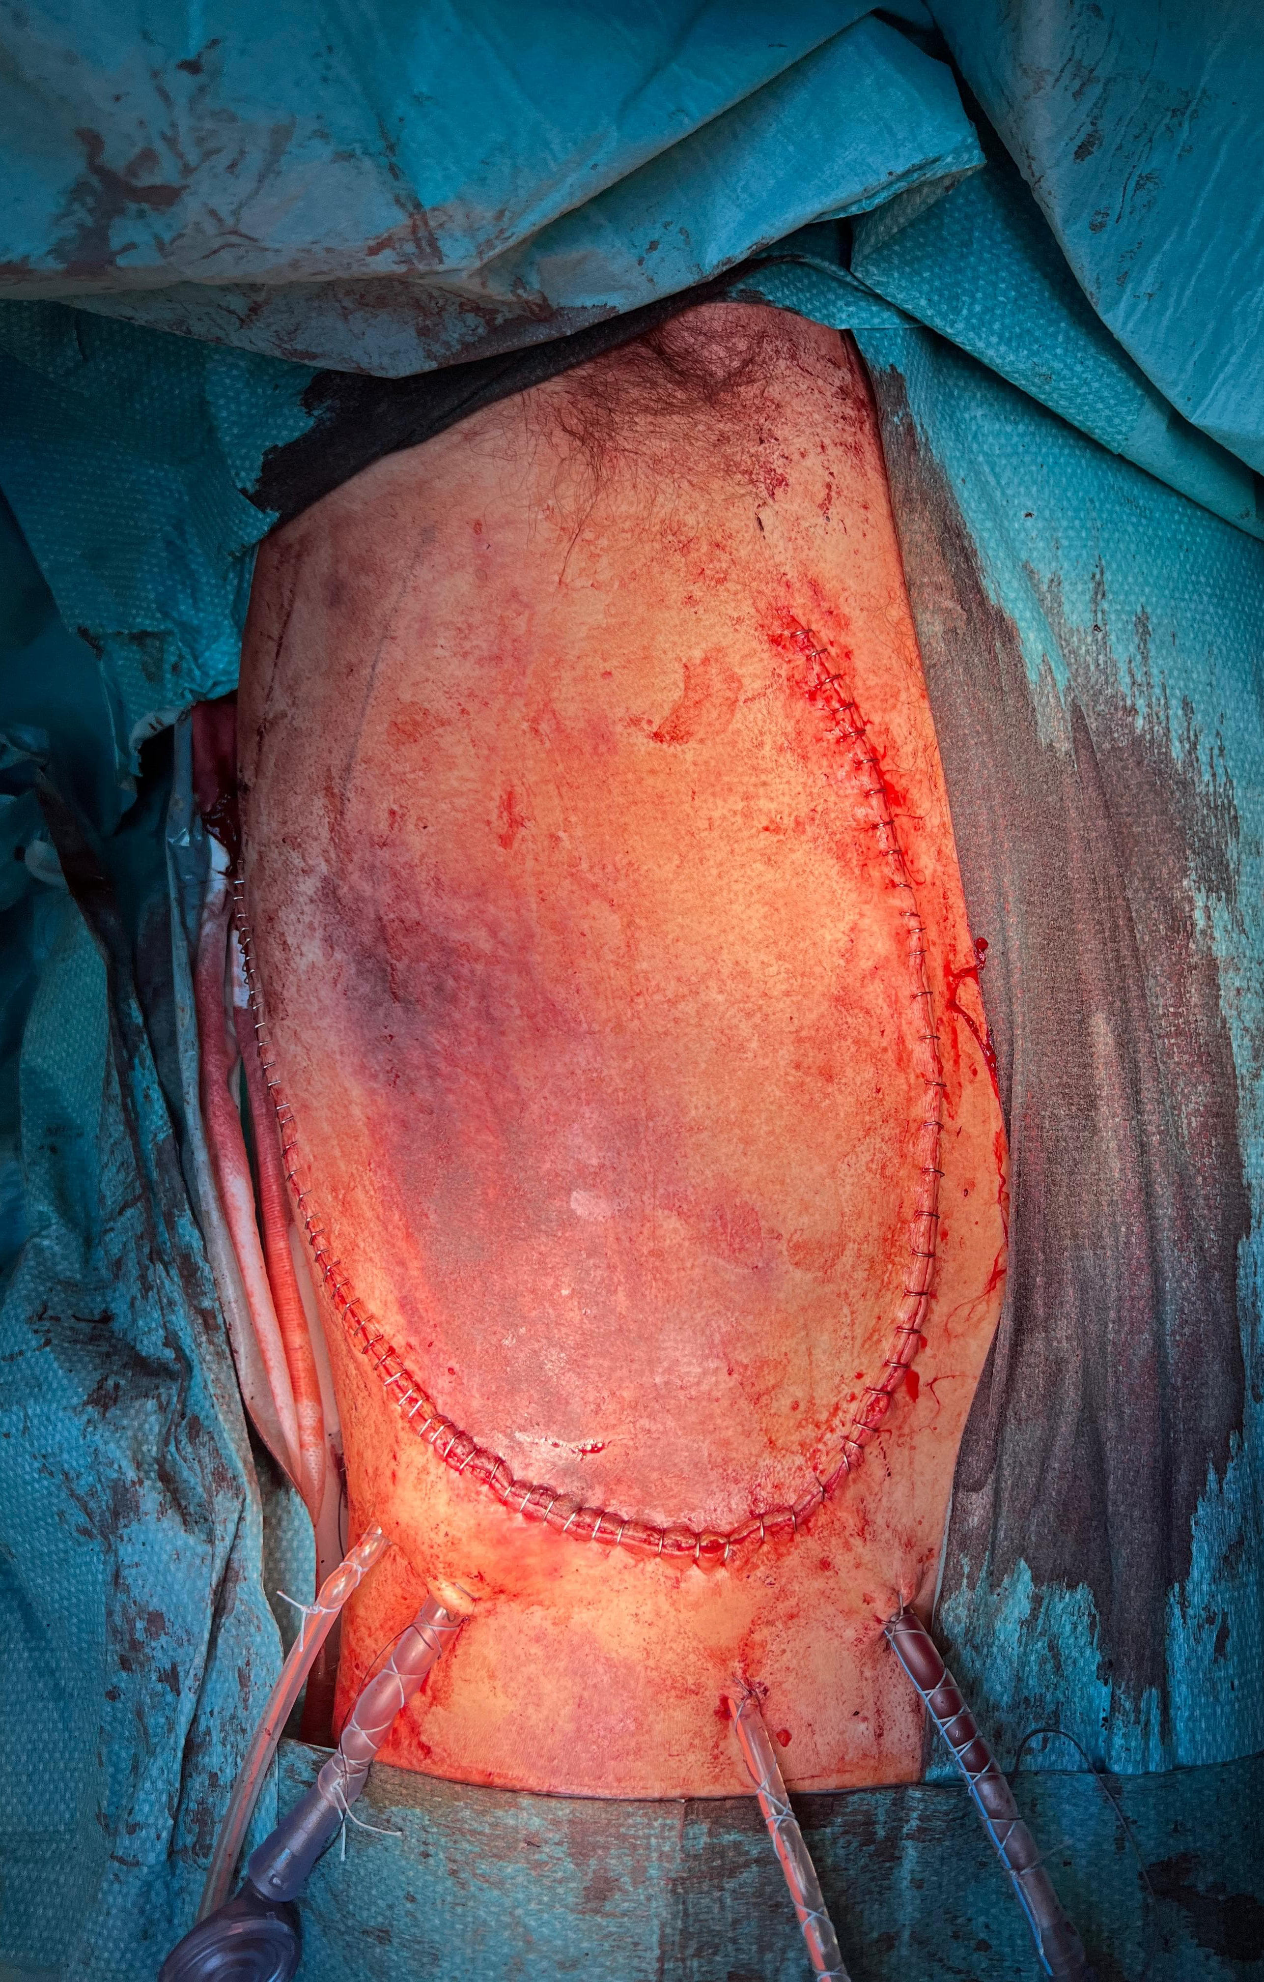
SURGERY
Ribs fixation open approach
Plates and screw

Slide 18
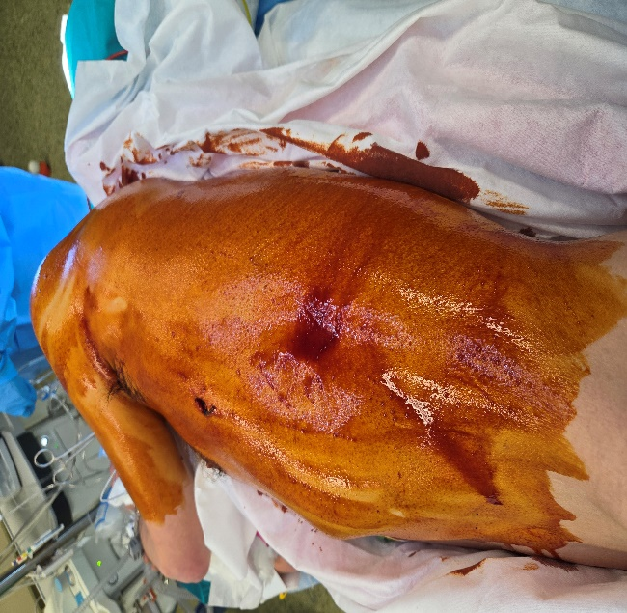
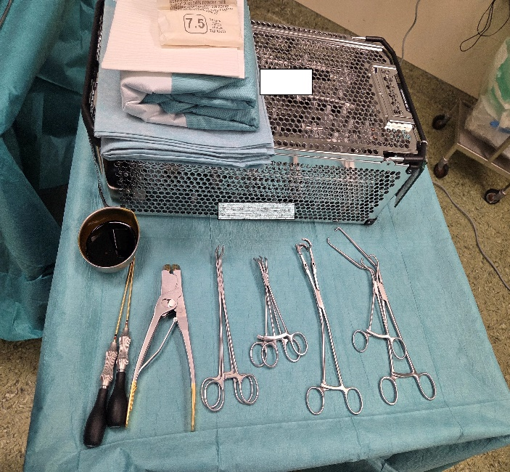
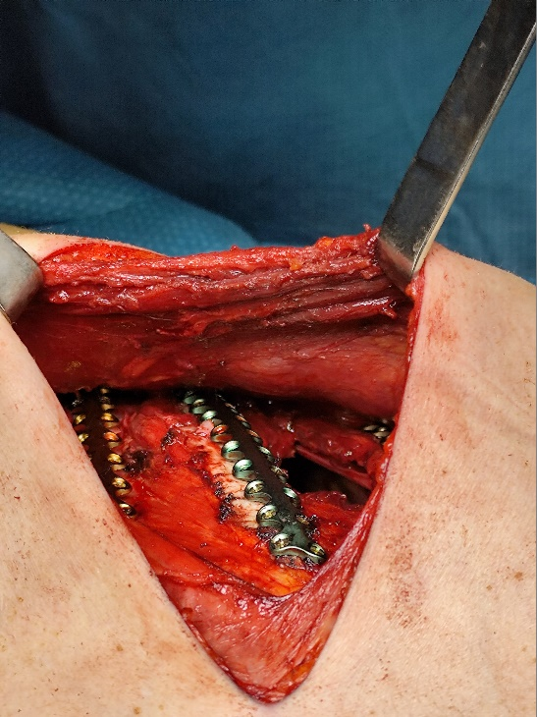
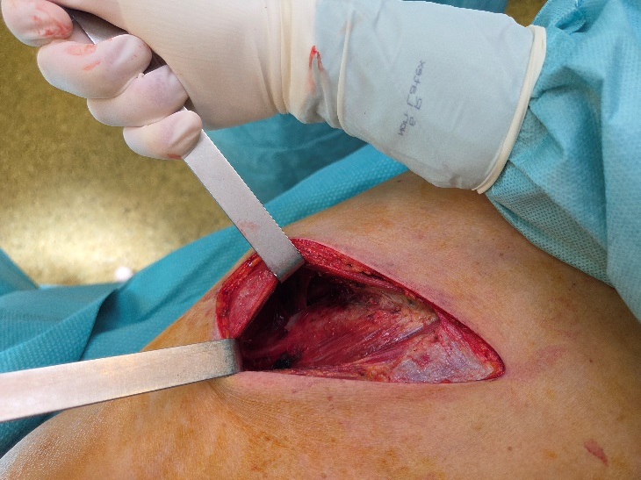
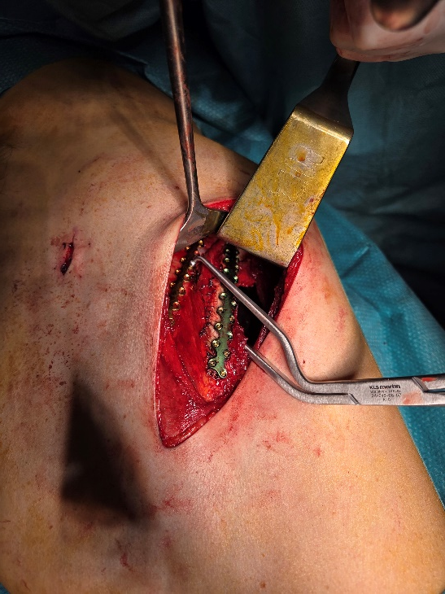
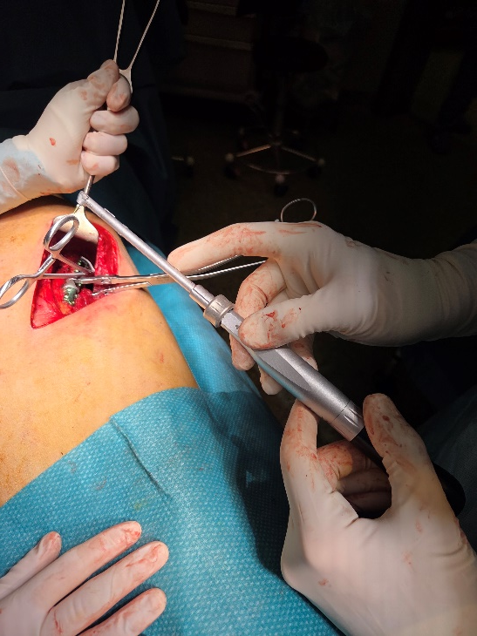
SURGERY

Slide 19
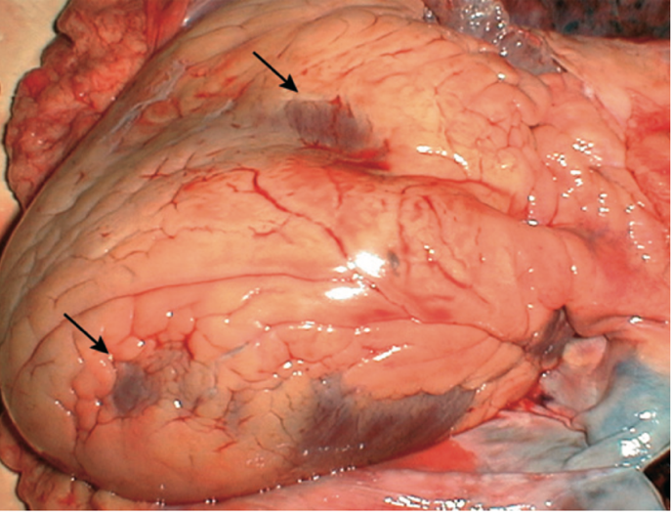
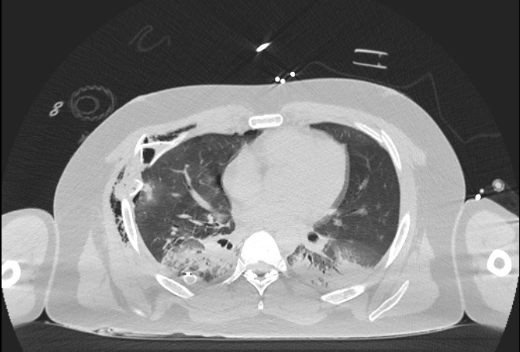
PULMONARY CONTUSIONS
Respiratory impairment
Maximal expression after 24/48h from the trauma
Spontaneous resolution within a week
May cause Acute Respiratory Distress Syndrome -> aggressive treatment, with steroids, protective ventilation

Slide 20
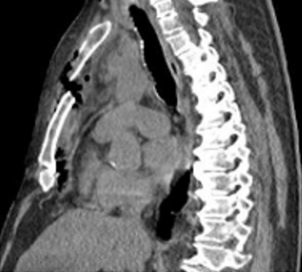
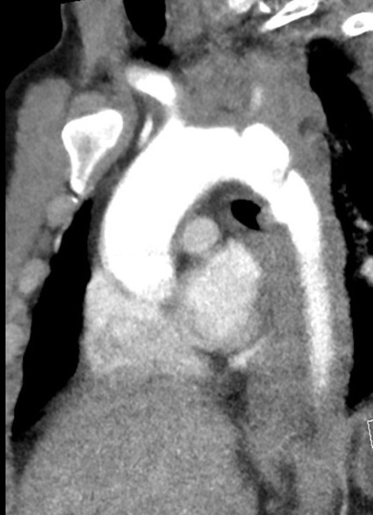
BLUNT AORTIC INJURY (BAI) and STERNAL FRACTURE
The rupture of the thoracic aorta at the isthmus is burdened by a high mortality rate: most patients die on the scene
Age > 60, front seat occupancy, no use of seatbelt, frontal or lateral collision, sudden deceleration 40 km/h, impact with sports vehicle
Strenal fracture: high-energy direct trauma associated or not with rapid deceleration
May be assocciated to heart/pericardial lesion
->Ecocardiografy is mandatory!
Notes:
which may occur when the driver’s chest hits the steering wheel or steering column or with sudden and strong braking from a transverse safety-belt

Slide 21
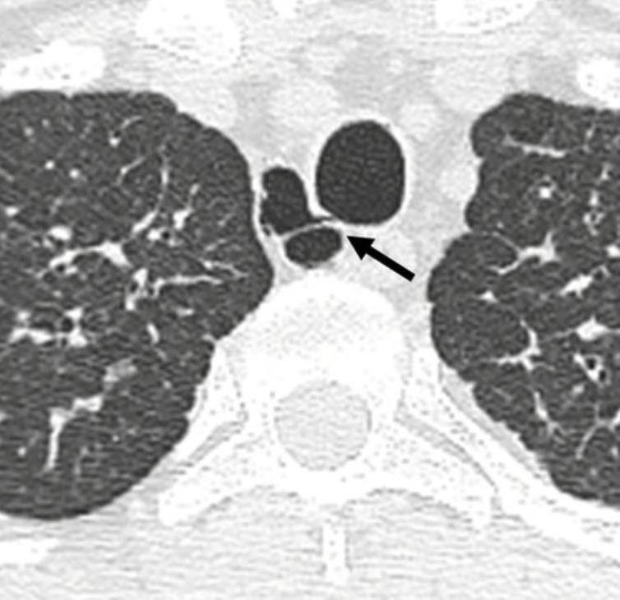
TRACHEO-BRONCHIAL INJURIES
Less than 1% of patients with blunt trauma
Often not recognized in time because of symptoms and signs unspecific
Pneumothorax, pneumomediastinum and/or subcutaneous emphysema
Diagnosis by Fibrobronchoscopy (FBS)
Usually do not require invasive treatments: conservative
(antibiotic coverage, drainage of a possible pneumothorax, intubation and low volume ventilation)

Slide 22
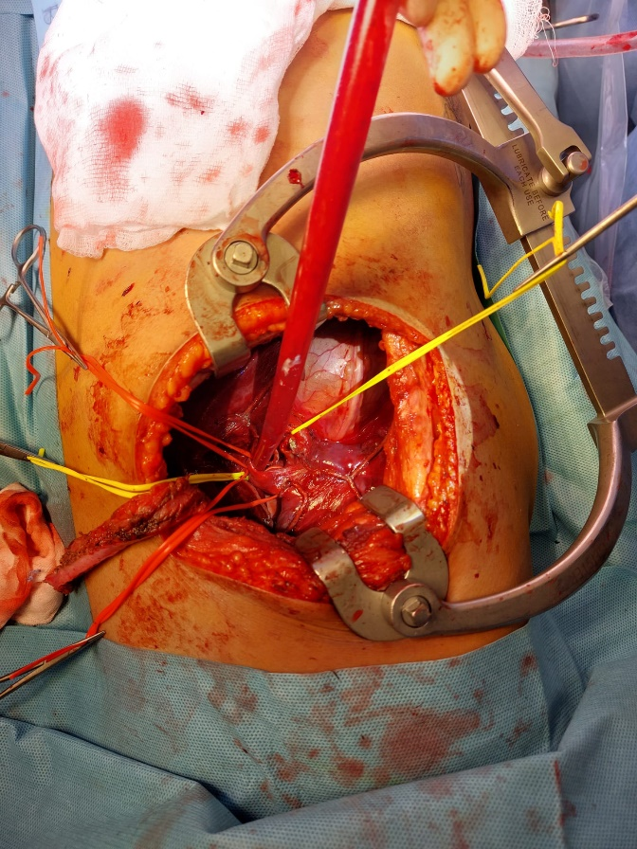
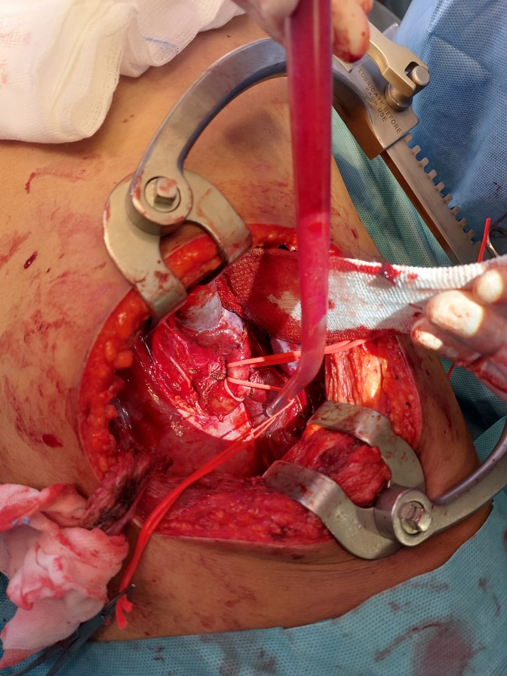
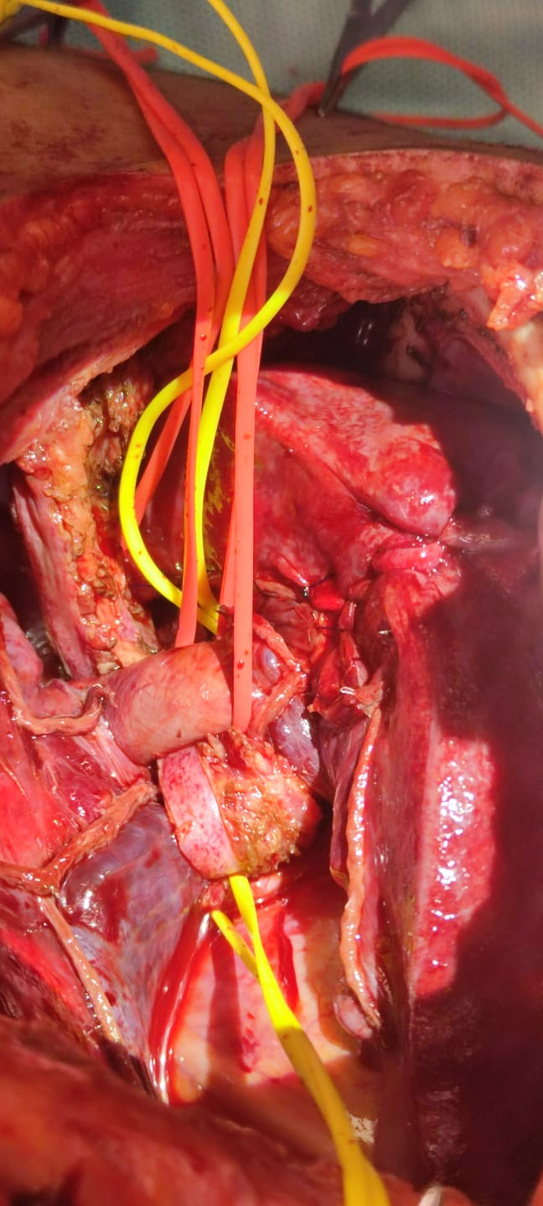
TRACHEO-BRONCHIAL INJURIES: surgical treatment

Slide 23
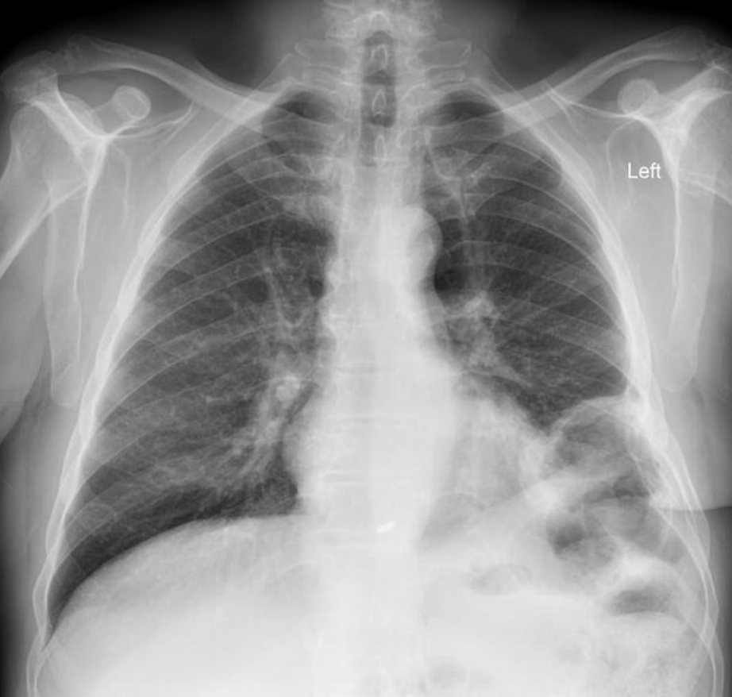
DIAPHRAGMATIC LESIONS
Penetrating injuries -> small diaphragmatic perforations,
Blunt trauma -> large radial tears of the diaphragm and easy herniation of abdominal viscera in thorax
-> Compression of the lung and reduced ventilation
-> Bowel obstruction
-> Mediastinal shift with decreased venous return and cardiac output
Surgical correction with suture through thoracoscopy or laparoscopy

Slide 24
Take home message
Trauma is a time-critical disease: early recognition and rapid, coordinated intervention save lives.
Damage Control principles matter: prioritize life-saving interventions, defer definitive repair until physiological stabilization.
Always think to the type of trauma in order to figure out all the possible damages
Thank you!!!!

